Slide 1

Twitter Data Analysis: Analyzing SuperBowl Fan support
TEAM: 6
ORION STAVRE, PUSHKAR KALE, WEI WANG, ZIRUI SONG
http://blogbaladi.com/twitter-to-enable-280-characters-tweets/

Slide 2
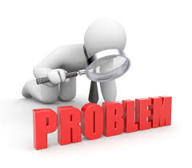
The Problem
Which team playing in the SuperBowl is supported more by its fans during the days before the superbowl?
http://whitecatcoaching.com.au

Slide 3
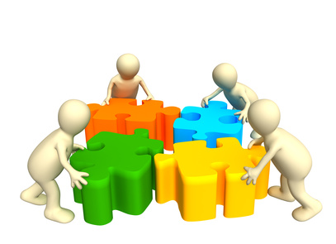
Our Approach
Downloaded up to 2,000 tweets with the hashtag #SuperBowlLII
Explored the tweets and its entities and analyzed:
The frequency of the most used words related to the superbowl
The most important tweets about the superbowl, most influential users and the most used hashtags
The frequency distribution of user mentions
The friends and followers of each team
The number of #’s supporting each team
http://home.btconnect.com/index.html

Slide 4
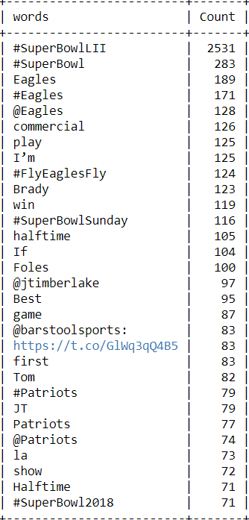
Frequency of Most used words
Most used words are sorted from Top-to-Bottom.
Common words like ‘the’, ‘or’, ‘to’, ’for’, ‘a’, ‘in’ have been excluded.

Slide 5

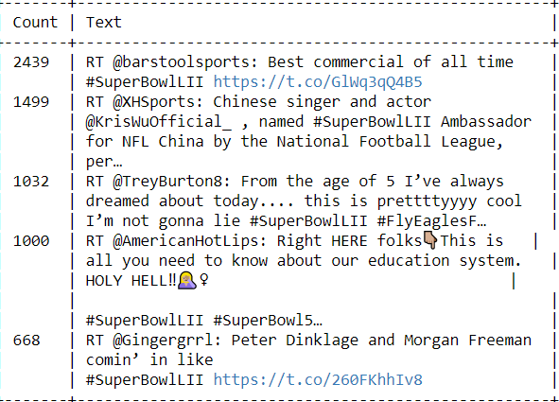
Most Retweeted Tweets
http://www.adweek.com/digital/most-retweets-twitter/

Slide 6
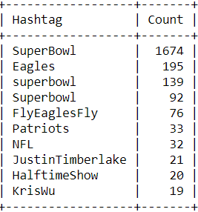
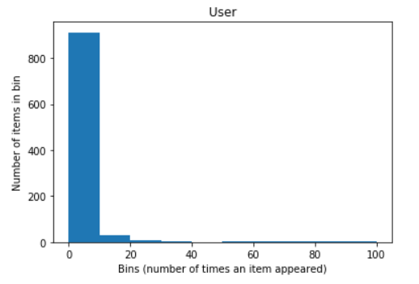
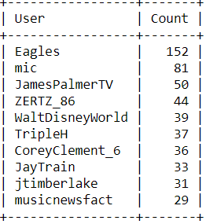
Most Popular Tweet Entities

Slide 7
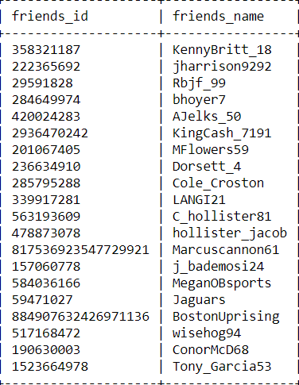
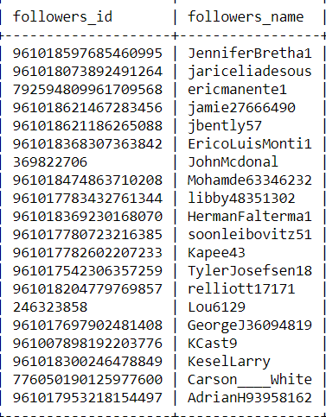

"All" friends and "All" followers of a popular user
Patriots
https://www.linkedin.com/pulse/difference-between-mobile-web-desktop-users-fazil-abdulkhader

Slide 8
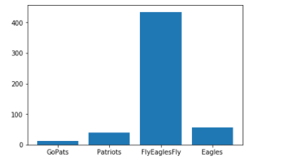
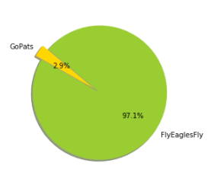
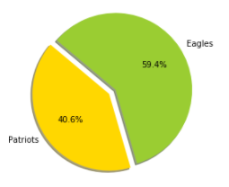
Which Team has maximum fan support?

Slide 9


https://www.dreamstime.com/stock-photo-q-icon-questions-answers-3d-man-image19473030
http://growsocially.com/thank-you-for-your-interest-in-our-marketing-training-services/

